Slide 1
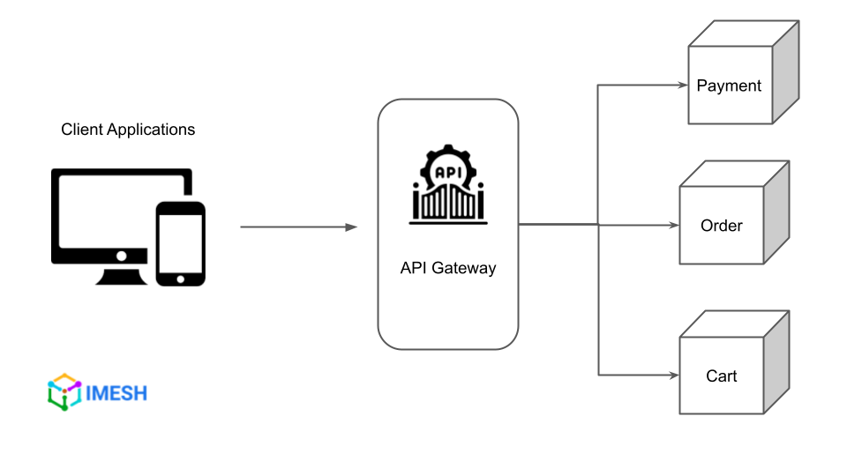
What is an API Gateway?
An API Gateway acts as a mediator between client applications and the backend services within the microservices architecture. It is a software layer that functions as a single endpoint for various APIs performing tasks such as request composition, routing, and protocol translation.
By providing an API for each client, API gateways encapsulate the complexity of the underlying system and let clients talk to it instead of calling specific services. They also perform security checks (authentication and authorization) before the traffic reaches the service, thus leaving services to focus on their core functionalities.

Slide 2
What is an API Gateway?
gRPC stands for Remote Procedure Calls and is an open-source framework for high-performance RPCs. It was developed by Google and released in August 2016. gRPC allows client applications to call methods on server applications on remote machines as easily as they would call methods on local objects. It's used in a variety of programming languages and platforms for cross-platform development and microservice architecture

Slide 3
The need for API gateways for microservices
The challenges posed by the direct client-to-microservices pattern of communication led to the popularity of API gateways. Let us go through some of them.
Coupling—client apps that do not have an API gateway pattern to mediate communication are coupled to internal microservices. When coupled, client applications must know how many parts of the application are split into microservices. When you evolve and refactor internal microservices, you impact maintenance. Because of the direct reference to these internal microservices from client apps, changes to the microservices causes breaking changes to client apps. It means you need to update client apps frequently, making it difficult to improve the solution.
Too many round trips—Consider a product page from the Amazon website. Some attributes like product pricing, quantity, and reviews will be deployed as different services in the backend. If the client is invoking services directly, it will have to make separate requests for each service (product price, reviews, quantity, etc.) to retrieve the required information, since there is no mechanism to cache a response from the upstream services. These calls add to the overhead of establishing multiple connections, and the round trips caused by these network requests add to latency and suboptimal user experience.

Slide 4
The need for API gateways for microservices
Security issues—an architecture that does not utilize an API gateway causes all microservices to be exposed externally, creating a larger attack surface. However, hiding internal microservices not directly used by a client app creates a smaller attack surface that strengthens the security of your application.
Diverse protocols affecting interoperability—The flexibility provided by microservices architecture lets developers build services using the language (Python, Java, Go) they choose. Similarly, they can implement those services in different API types, such as REST, gRPC, and others. In a direct client-to-microservice communication pattern, it then becomes a requirement for the client to understand and communicate using different protocols. This adds additional complexity as the client application will require more code and logic..

Slide 5
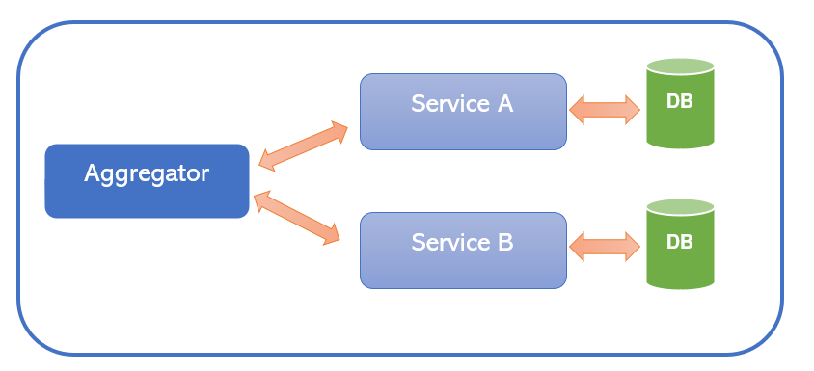
What is an Aggregator Pattern?
In Microservices Architecture, we split a large, complex application into small, autonomous, independently deployable services. Therefore, it’s necessary to think about how to collaborate the data returned by each service. In IT industry, aggregator refers to a website or program that collects related items of data and displays them. So, in microservices the Aggregator Design Pattern is a service that receives a request, then makes requests of multiple services, combines the results and responds to the initiating request.

Slide 6
In Aggregator Pattern, there are 3 ways to implement it within Microservices application
Scatter Gather Pattern: When you invoke the Grading System’s service, you can send a parallel call to the “Student Information” and “Marks Information” services, and get those responses to aggregate them as a single response. Now we can send this response back to the Grading System (consumer). So, this is the first solution and it called as “Scatter gather pattern.”
Chained Pattern: Assume the Marks Information service has a dependency on the Student Information service. In that case, you can’t use the Scatter Gather pattern. So, what we can do is invoke the “Student Information” service and get the Student Code along with the response, then pass to the “Marks Information” service. At last, get the marks and its related information and response back to the Grading System. So, this is the second solution and it called as “Chained Pattern.” However, this pattern is slower than the Scatter gather pattern.

Slide 7
In Aggregator Pattern, there are 3 ways to implement it within Microservices application
Branching Pattern: This microservices pattern is a mix of Aggregator and Chain design patterns, that allows simultaneous request or response from two or more independent microservices. As you already know, a microservice may need to get the data from multiple sources including other microservices. The Branching Pattern extends the Aggregator Pattern and provides the flexibility to produce responses from multiple chains or single chain. This design pattern comes handy when you need to convert a large monolithic application into a microservices application. To get things clearer, check the following diagram.

Slide 8
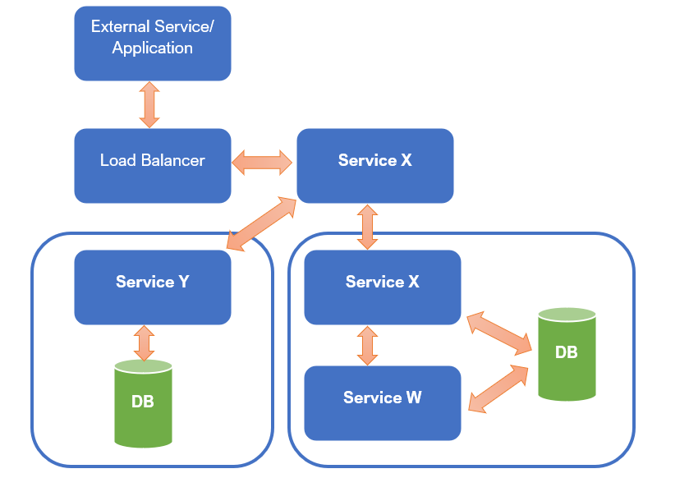
Branch pattern

Slide 9
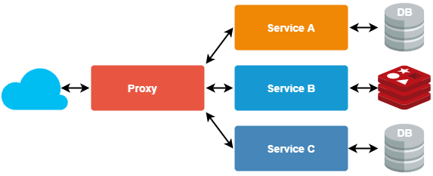
Proxy pattern
https://medium.com/nerd-for-tech/design-patterns-for-microservices-aggregator-pattern-99c122ac6b73

Slide 10
Proxy Design Pattern
Assume your client has a monolithic application and they decided to move it into microservices architecture. In that case your team might assigned to develop multiple services and deploy those continuously. While developing these microservices, there might be scenarios that some services require changes, like updating their functionalities. Updating a particular service can affect the other services, which consume that services. As a result, this might be led to a whole system break, and also it will hold the development of the application. However, we have a well-known solution for this type of situations: The Proxy Design Pattern.

Slide 11
The Database-per-Service pattern
Loose coupling is the core characteristic of a microservices architecture, because each individual microservice can independently store and retrieve information from its own data store. By deploying the database-per-service pattern, you choose the most appropriate data stores (for example, relational or non-relational databases) for your application and business requirements. This means that microservices don't share a data layer, changes to a microservice's individual database do not impact other microservices, individual data stores cannot be directly accessed by other microservices, and persistent data is accessed only by APIs. Decoupling data stores also improves the resiliency of your overall application, and ensures that a single database can't be a single point of failure.

Slide 12
By using the Database-per-Service Pattern in microservices:
Data schema changes made easy without impacting other microservices
Each microservice has its own data store, preventing accidental or unauthorized access to another service’s data.
Since each microservice and its database are separate, they can be scaled independently based on their specific needs.
If one of the database server is down, this will not affect to other services.

Slide 13
Downsides of Database Per Service Pattern
It might be challenging to implement complex transactions and queries that span multiple microservices or data stores.
You have to manage multiple relational and non-relational databases.
Your data stores must meet two of the CAP theorem requirements: consistency, availability, or partition tolerance.

Slide 14
Shared Database Pattern in Microservices
In the shared-database-per-service pattern, the same database is shared by several microservices. We need to carefully assess the application architecture before adopting this pattern, and make sure that we avoid hot tables (single tables that are shared among multiple microservices). All your database changes must also be backward-compatible; for example, developers can drop columns or tables only if objects are not referenced by the current and previous versions of all microservices.

Slide 15
** Advantages of Shared Database Design Pattern **
You should consider using this pattern if:
You don't want too much refactoring of your existing code base.
You enforce data consistency by using transactions that provide atomicity, consistency, isolation, and durability (ACID).
You want to maintain and operate only one database.
Implementing the database-per-service pattern is difficult because of interdependencies among your existing microservices.
You don’t want to completely redesign your existing data layer.

Slide 16
** Challenges with Shared Database**
Sharing the database is sharing the logic
Risk of data corruption and deletion
There is a risk that one of the services might corrupt or delete some data given that the database is shared between the services.
Abusing the shared database
One service firing expensive queries on the database will affect the performance of other services sharing the same database.

Slide 17
** ** Usage of this Design Pattern ****
1. Use this pattern when you don't want too much refactoring of your existing code base.
2. Use this pattern when you enforce data consistency by using transactions that provide atomicity, consistency, isolation, and durability (ACID).
3. Use this pattern when you want to maintain and operate only one database.
4. Use this pattern when you don’t want to completely redesign your existing data layer.
5. Use this pattern when you want each service is free to use data accessible to other services.

Slide 18
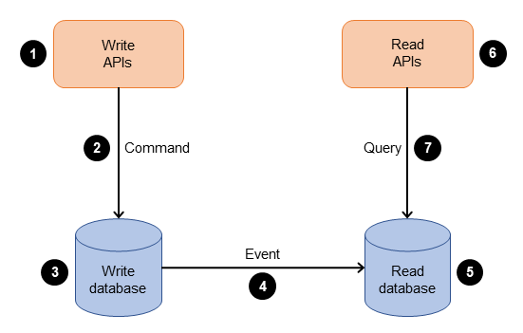
** ** CQRS pattern****
1. The command query responsibility segregation (CQRS)
The CQRS pattern splits the application into two parts—the command side and the query side
The command side handles create, update, and delete requests. The query side runs the query part by using the read replicas

Slide 19
** ** When to Use CQRS pattern ****
CQRS Design Pattern is useful where the data reading / accessing performance has become very slow due to a large number of read and write operations going on simultaneously, which can be due to a lot of load on the database, and/or the network on which the database resides.
CQRS pattern is useful in the situation when reading data performance needs to be optimized separately from writing data performance, especially if the reading data queries are much more in number than the writing data queries.

Slide 20
** ** What is the saga pattern****
saga is a sequence of local transactions. Each service in a saga performs its own transaction and publishes an event. The other services listen to that event and perform the next local transaction.
types of Saga:
1- Orchestration-Based Saga. 2- Choreography-Based Saga.
The saga orchestration pattern uses a central coordinator (orchestrator) to help preserve data integrity in distributed transactions that span multiple services. In a distributed transaction, multiple services can be called before a transaction is completed. When the services store data in different data stores, it can be challenging to maintain data consistency across these data stores.

Slide 21
Saga orchestration
The saga orchestration pattern has a central coordinator called an orchestrator. The saga orchestrator manages and coordinates the entire transaction lifecycle. It is aware of the series of steps to be performed to complete the transaction. To run a step, it sends a message to the participant microservice to perform the operation. The participant microservice completes the operation and sends a message back to the orchestrator. Based on the message it receives, the orchestrator decides which microservice to run next in the transaction.
The saga orchestration pattern is suitable when there are many participants, and loose coupling is required between saga participants. The orchestrator encapsulates the complexity in the logic by making the participants loosely coupled. However, the orchestrator can become a single point of failure because it controls the entire workflow.

Slide 22
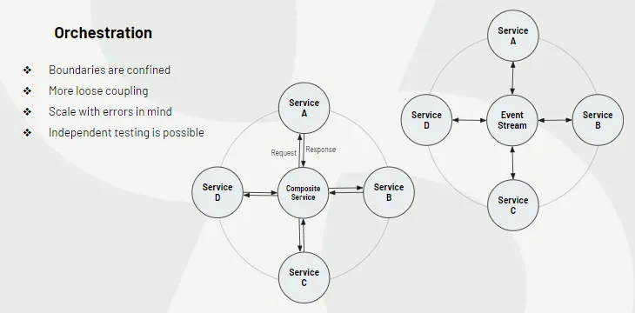

Slide 23
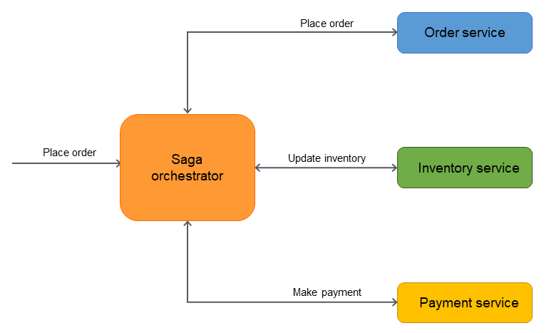

Slide 24
Saga choreography
The saga choreography pattern depends on the events published by the microservices. The saga participants (microservices) subscribe to the events and act based on the event triggers. For example, the order service in the following diagram emits an OrderPlaced event. The inventory service subscribes to that event and updates the inventory when the OrderPlaced event is emitted. Similarly, the participant services act based on the context of the emitted event.
The saga choreography pattern is suitable when there are only a few participants in the saga, and you need a simple implementation with no single point of failure. When more participants are added, it becomes harder to track the dependencies between the participants by using this pattern.

Slide 25
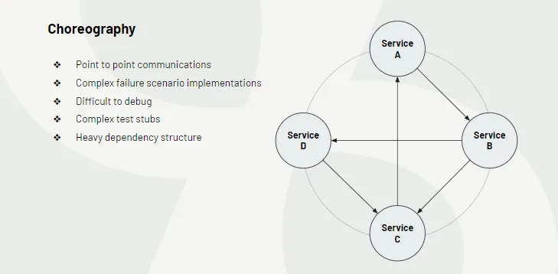

Slide 26
** ** Benefits of the saga pattern****
The saga pattern offers several benefits for microservices, such as ensuring data consistency and reliability without using distributed transactions or locking mechanisms. It allows each service to have its own database and data model that best fits its domain and logic, avoiding the need for a shared database or schema. Additionally, it supports asynchronous communication and event-driven architecture which can improve responsiveness and resilience of the system. Moreover, it provides a clear and traceable workflow of the business process and its outcomes, which can facilitate debugging and monitoring.

Slide 27
** ** challenges of the saga pattern****
The saga pattern has some challenges that need to be addressed, such as increasing the complexity and coordination of the system, introducing eventual consistency and partial failures, requiring careful testing and validation of the saga steps and their interactions, as well as the recovery and rollback scenarios. Moreover, it may affect the user experience and expectations, as you need to communicate the status and results of the saga to the end users and handle their feedback and requests.

Slide 28
** ** Aynchronous Messaging pattern****
When multiple microservices need to call each other and wait for long operations until finished, then we should use asynchronous communication. Asynchronous communication allows the caller to continue working without waiting for a response from recipient. This is often preferred when the caller does not need an immediate response, such as sending notifications like SMS, email for registration or order confirmation in online store etc.

Slide 29
** ** Aynchronous Messaging pattern****
In a microservices-based software system, inter-process communication is vital for applications to exchange information. Microservices can interact with each other through two primary communication mechanisms:
Synchronous Communication (Request-Reply): In this mode, one service initiates communication by invoking an API provided by another service and then awaits a response. For effective use, the API should have well-defined semantics and support versioning.
Asynchronous Communication: In contrast, asynchronous communication involves a service dispatching a message without expecting an immediate response. Multiple services can potentially handle and process these messages.

Slide 30
** ** Usage of Aynchronous Messaging pattern****
Use this pattern to decouple microservices.
2. Use this pattern to achieve scalability to handle more load by adding more consumers for the queue.
3. Use this pattern to achieve reliability via queue so that if consumer is not available so messages will be stored safe or requeue in case of any failure.
4. Use this pattern to achieve testability.

Slide 31
** ** Disadvantages of Asynchronous Patterns****
Asynchronous patterns do increase complexity. We have to send a message, listen to a reply queue, and route the message to the sending client based on a message ID rather than sending a message and waiting for a reply.
The other disadvantage is that we must necessarily add latency in the Microservice because we employ asynchronous communication and build a queue between components. We are adding two hops on each side in place of direct communication. These sides can define as service to queue and queue to the receiving service.

Slide 32
** ** Event Sourcing pattern****
A service command typically needs to create/update/delete aggregates in the database and send messages/events to a message broker. For example, a service that participates in a saga needs to update business entities and send messages/events. Similarly, a service that publishes a domain event must update an aggregate and publish an event.
Event sourcing is a Microservice design pattern that involves capturing all changes to an application’s state as a sequence of events, rather than simply updating the state itself. Each event represents a discrete change to the system and is stored in an event log, which can be used to reconstruct the system’s state at any point in time.

Slide 33
** ** Log Aggregation pattern****
In Microservice architecture the application consists of multiple services and service instances that are running on multiple machines. Each service instance generates information about what it is doing to a log file in a standardized format.
Log aggregation is the mechanism for capturing, normalizing, and consolidating logs from different sources to a centralized platform for correlating and analysing the data. This aggregated data then acts as a single source of truth for different use cases, including troubleshooting application performance issues or errors, identifying infrastructure bottlenecks, or finding the root cause of a cyberattack.

Slide 34
Performance Metrics
Distributed Tracing
Assigns each external request a unique external request id
Passes the external request id to all services that are involved in handling the request
Includes the external request id in all log messages
Records information (e.g. start time, end time) about the requests and operations performed when handling a external request in a centralized service

Slide 35
Externalized Configuration
In microservices architectures, systems are split into several services (microservices), each one usually running in a separate process. Each process can be deployed and scaled independently, and this means there may be many instances of the same microservice running at a certain time.
Let’s say you want to modify the configuration for a microservice that has been replicated a hundred times (one hundred processes are running). If the configuration for this microservice is packaged with the microservice itself, you’ll have to redeploy each of the one hundred instances. This can result in some instances using the old configuration, and some using the new one, at some point. Moreover, sometimes microservices use external connections which, for example, require URLs, usernames, and passwords. If you want to update these settings, it would be useful to have this configuration shared across services.

Slide 36
A service discovery pattern enables locating microservices within the network. It uses a service registry (a centralized server) to keep a global record of all microservices’ network locations.
All microservices must register and disclose their locations to the central service registry at set intervals.

Slide 37
Service Discovery in a Microservices
Let’s imagine that you are writing some code that invokes a service that has a REST API or Thrift API. In order to make a request, your code needs to know the network location (IP address and port) of a service instance. In a traditional application running on physical hardware, the network locations of service instances are relatively static. For example, your code can read the network locations from a configuration file that is occasionally updated.
In a modern, cloud‑based microservices application, however, this is a much more difficult problem to solve
Service instances have dynamically assigned network locations. Moreover, the set of service instances changes dynamically because of autoscaling, failures, and upgrades. Consequently, your client code needs to use a more elaborate service discovery mechanism.

Slide 38
The Client‑Side Discovery Pattern
When using client‑side discovery, the client is responsible for determining the network locations of available service instances and load balancing requests across them. The client queries a service registry, which is a database of available service instances. The client then uses a load‑balancing algorithm to select one of the available service instances and makes a request.
The network location of a service instance is registered with the service registry when it starts up. It is removed from the service registry when the instance terminates. The service instance’s registration is typically refreshed periodically using a heartbeat mechanism.

Slide 39
The Client‑Side Discovery Pattern
The client‑side discovery pattern has a variety of benefits and drawbacks. This pattern is relatively straightforward and, except for the service registry, there are no other moving parts. Also, since the client knows about the available services instances, it can make intelligent, application‑specific load‑balancing decisions such as using hashing consistently. One significant drawback of this pattern is that it couples the client with the service registry. You must implement client‑side service discovery logic for each programming language and framework used by your service clients.

Slide 40
The Server‑Side Discovery Pattern
The client makes a request to a service via a load balancer. The load balancer queries the service registry and routes each request to an available service instance. As with client‑side discovery, service instances are registered and deregistered with the service registry.
The server‑side discovery pattern has several benefits and drawbacks. One great benefit of this pattern is that details of discovery are abstracted away from the client. Clients simply make requests to the load balancer. This eliminates the need to implement discovery logic for each programming language and framework used by your service clients. Also, as mentioned above, some deployment environments provide this functionality for free. This pattern also has some drawbacks, however. Unless the load balancer is provided by the deployment environment, it is yet another highly available system component that you need to set up and manage.

Slide 41
The Self‑Registration Pattern
When using the self‑registration pattern, a service instance is responsible for registering and deregistering itself with the service registry. Also, if required, a service instance sends heartbeat requests to prevent its registration from expiring. The following diagram shows the structure of this pattern.

Slide 42
The Third‑Party Registration Pattern
When using the third-party registration pattern, service instances aren’t responsible for registering themselves with the service registry. Instead, another system component known as the service registrar handles the registration. The service registrar tracks changes to the set of running instances by either polling the deployment environment or subscribing to events. When it notices a newly available service instance it registers the instance with the service registry. The service registrar also deregisters terminated service instances

Slide 43
Circuit Breaker Pattern
The circuit breaker pattern is inspired by the electrical circuit breaker, which is a device that automatically interrupts the current flow when a fault is detected, such as a short circuit or an overload. The circuit breaker protects the electrical system from damage and allows the fault to be isolated and fixed. Similarly, the circuit breaker pattern is a software component that monitors the communication between a service and its dependencies, such as other services, databases, or external APIs. The circuit breaker detects failures and breaks the connection to the faulty dependency, preventing further requests from being sent and wasting resources. The circuit breaker also provides a fallback mechanism to handle the failure gracefully, such as returning a default value, a cached response, or an error message. The circuit breaker can also recover from the failure by periodically checking the status of the dependency and restoring the connection when it is available again.

Slide 44
How does the circuit breaker work
The circuit breaker works by switching between three states: closed, open, and half-open. In the closed state, the circuit breaker allows requests to pass through to the dependency normally. It also records the success and failure of each request and calculates the failure rate or the number of consecutive failures. If the failure rate or the number of consecutive failures exceeds a predefined threshold, the circuit breaker transitions to the open state. In the open state, the circuit breaker rejects all requests to the dependency and returns a fallback response. It also starts a timer to track the duration of the open state. When the timer expires, the circuit breaker transitions to the half-open state. In the half-open state, the circuit breaker allows a limited number of requests to pass through to the dependency and evaluates the outcome. If the requests are successful, the circuit breaker transitions back to the closed state. If the requests fail, the circuit breaker transitions back to the open state and resets the timer.

Slide 45
What are the challenges of using the circuit breaker in your microservices
Using the circuit breaker in your microservices can also pose some challenges. You need to choose the right parameters and thresholds for your circuit breaker, such as the failure rate, consecutive failures, timeout duration, and requests in the half-open state. These parameters can affect the sensitivity and responsiveness of your circuit breaker, as well as the trade-off between availability and consistency. Testing and debugging your circuit breaker is essential, especially in complex environments with multiple services and dependencies. You may need to simulate different failure scenarios and verify how your circuit breaker reacts. Additionally, tools and techniques like logging, dashboards, and distributed tracing can be used to monitor and trace circuit breaker events and metrics. Finally, you should coordinate and communicate your circuit breaker strategy and configuration across teams to ensure consistency among implementations.

Slide 46
Blue Green Deployment
Blue green deployment is a deployment strategy in which you create two separate, but identical environments. One environment (blue) is running the current application version and one environment (green) is running the new application version. Blue-green deployment is a technique that reduces downtime and risk. This runs two identical production environments called Blue and Green. At any time, only one of the environments is live, serving all production traffic.
Once testing has been completed on the green environment, live application traffic is directed to the green environment and the blue environment is deprecated. A number of AWS deployment services support blue/green deployment strategies including Elastic Beanstalk, OpsWorks, CloudFormation, CodeDeploy, and Amazon ECS.

Slide 47
API GateWay vs Proxy
API proxy
An API proxy acts as an intermediary, focusing on routing requests, handling transformations, and managing security features. Well-suited for microservices architectures, it includes caching and offers endpoint-level monitoring and analytics
API gateway
An API gateway serves as a central entry point for multiple APIs, streamlining access across microservices. It excels in aggregating data, translating requests between protocols, distributing requests for load balancing, and orchestrating complex interactions.

Slide 48
API GateWay vs Proxy
Service orchestration: API orchestration is the process of managing multiple API calls from different microservices and aggregating the results into a single response. This can be helpful when you need to retrieve data from various sources.
Transformation: As well as transforming the data itself, API gateways can also transform the structure of an API request or response. This can be helpful in cases where you need to change the format of the API’s returned data. Changes may include adding or removing fields or headers, changing the data type of a field, or filtering out specific data.
Load Balancing: API gateways can distribute load among multiple servers, improving performance and reducing latency. This is especially helpful when you have many users making requests to the API.

Slide 49
API GateWay vs Proxy
A proxy server, sometimes referred to as a forward proxy, is a server that routes traffic between client(s) and another system, usually external to the network. By doing so, it can regulate traffic according to preset policies, convert and mask client IP addresses, enforce security protocols, and block unknown traffic.
A reverse proxy is a type of proxy server. Unlike a traditional proxy server, which is used to protect clients, a reverse proxy is used to protect servers. A reverse proxy is a server that accepts a request from a client, forwards the request to another one of many other servers, and returns the results from the server that actually processed the request to the client as if the proxy server had processed the request itself. The client only communicates directly with the reverse proxy server and it does not know that some other server actually processed its request

Slide 50
Reverse Proxy vs Forward Proxy
The difference between a forward and reverse proxy is subtle but important. A simplified way to sum it up would be to say that a forward proxy sits in front of a client and ensures that no origin server ever communicates directly with that specific client. On the other hand, a reverse proxy sits in front of an origin server and ensures that no client ever communicates directly with that origin server.

Slide 51
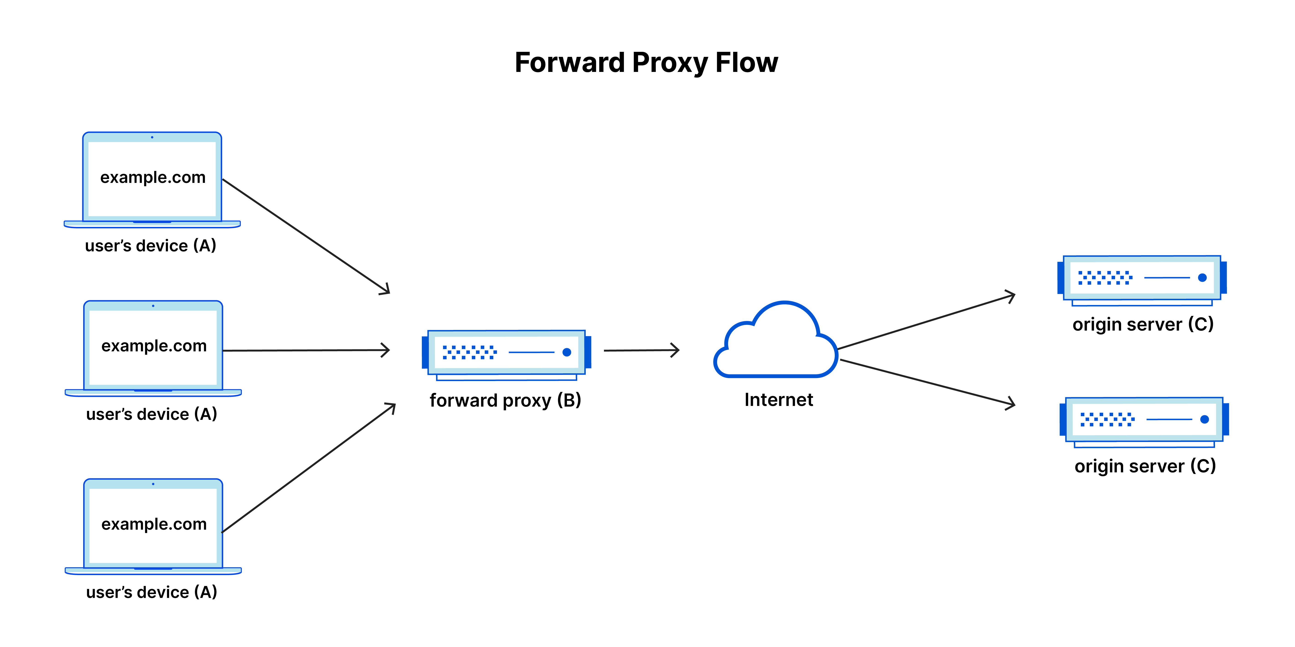

Slide 52
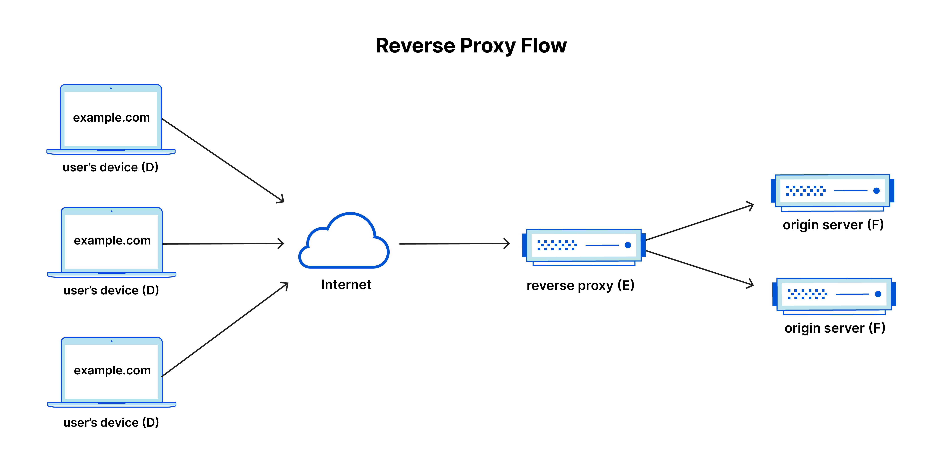

Slide 53
Performance Metrics
https://medium.com/cloud-native-daily/microservices-monitoring-and-observability-in-depth-d40aa0795dd3

